Slide 1
Algorithms Project Assignment 4
Kuilin Wang
Huynh Manh
Iris Linck

Slide 2
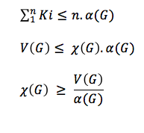
Independence Number - α
K_{i} = Number of vertices within a independent set.
K_{i} ≤ α(G)
n = number of sets of independent vertices

Slide 3
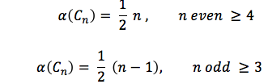
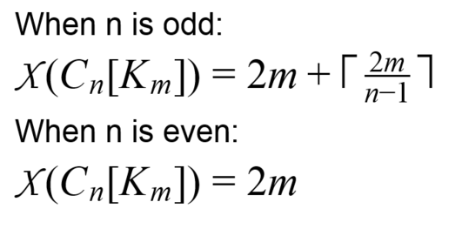
Independence Number and Chromatic Number
Independence Number
(Griggs,1983)
Chromatic Number

Slide 4



Χ(C₁₁[K₆]) = 14
1. We assume that each odd cycle by removing one vertex becomes 2-colorable, so we need 2m colors.
2. We put all uncolored vertex in a special way, we distributed these vertices in different cycles by skipping one neighbor and then we need (2m/n-1) colors to color them.
3. The no-colored vertices will be grouped in several sets of (n - 1)/2 vertices and each group will be colored by the same color.

Slide 5
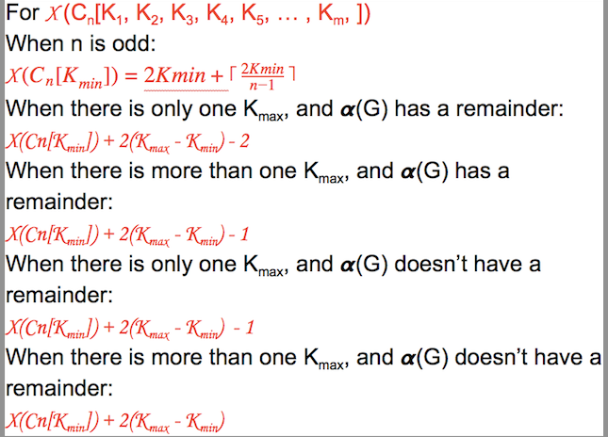

Slide 6
The independence number α(G) is the same as α(G[r₁, r₂, …, r_{n}]because r_{i} just add more edges among the same adjacent vertices, in other words, if you replace a complete graph for each vertex it does not generate a new non-adjacent vertex.

Slide 7
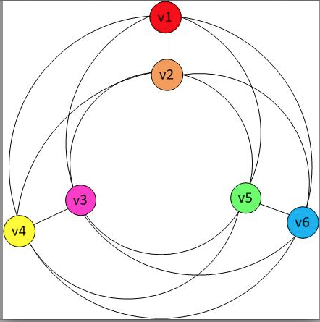
c) Chromatic number of C₃[2,2,2]
Lower bound:
X(C₃[2,2,2] ≥ 6/1
≥ 6
Upper Bound:
X(C₃[2,2,2] ≤ 6
X(C₃[2,2,2] = 6
QED

Slide 8
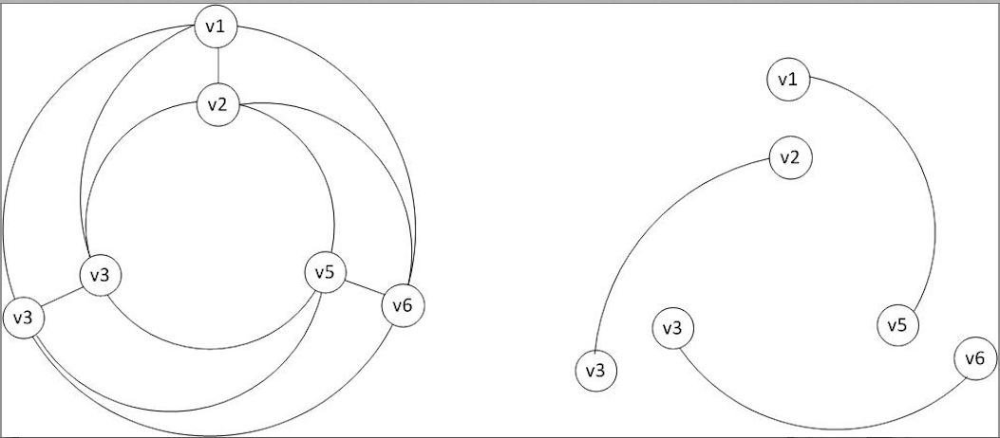
c) Thickness of C₃[2,2,2]
According to the Four-Color Theorem, the chromatic number of a planar graph is 4. But C₃[2,2,2] is 6-colorable, so the thickness ≥ 2.
Upper bound:
Θ(C₃[2,2,2]) ≤ 2
Θ(C₃[2,2,2]) = 2
QED

Slide 9
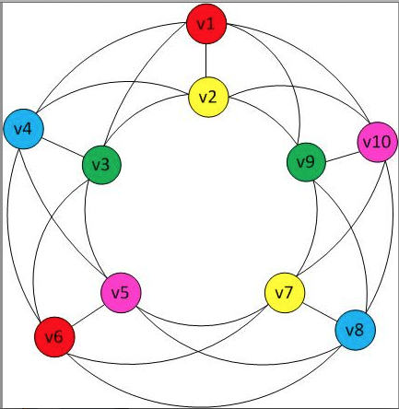
d) Chromatic number and Thickness of C₅[2,2,2,2,2]
Lower bound:
X(C₅[2,2,2,2,2] ≥ 10/2
≥ 5
Upper Bound:
X(C₅[2,2,2,2,2] ≤ 5
X(C₅[2,2,2,2,2] = 5
QED

Slide 10
d) Chromatic number of C₅[2,2,2,2,2]
Lower bound:
X(C₅[2,2,2,2,2] ≥ 10/2
≥ 5
Upper Bound:
X(C₅[2,2,2,2,2] ≤ 5
X(C₅[2,2,2,2,2] = 5
QED

Slide 11
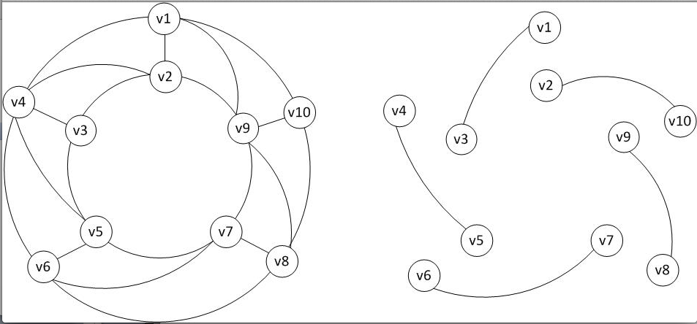
d) Thickness of C₅[2,2,2,2,2]
According to the Four-Color Theorem, the chromatic number of a planar graph is 4. But C₅[2,2,2,2,2] is 5-colorable, so the thickness ≥ 2.
Upper bound:
Θ(C₅[2,2,2,2,2]) ≤ 2
Θ(C₅[2,2,2,2,2]) = 2
QED

Slide 12
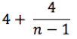
e) Chromatic number and Thickness of C_{n}[2,2,…,2]
Lower bound:
θ(Cn[2,2,…, 2]) ≥ 2
Lower bound when n is even
X(C_{n}[2,2,…,2] ≥ 2n / (n/2)
≥ 4
Lower bound when n is odd and n ≥ 5
X(C_{n}[2,2,…,2] ≥ 2n / ((n – 1) / 2))
≥

Slide 13
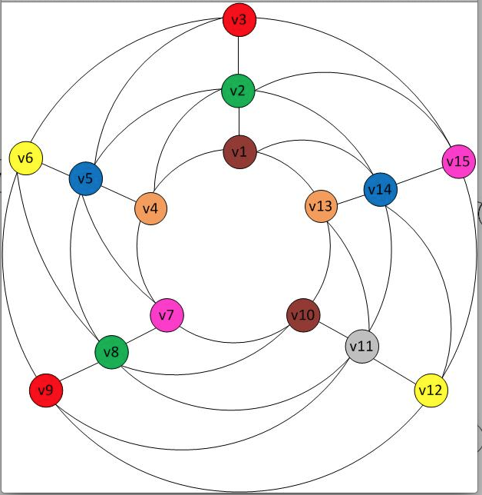
f) Chromatic number of C₅[3,3,3,3,3]
Lower bound:
X(C₅[3,3,3,3,3] ≥ 15/2
≥ 7.5
Upper Bound:
X(C₅[2,2,2,2,2] ≤ 8
X(C₅[2,2,2,2,2] = 8
QED

Slide 14
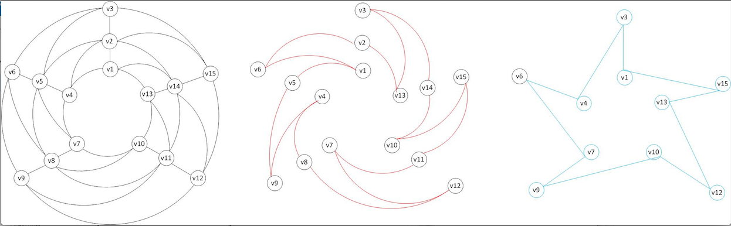
f) Thickness of C₅[3,3,3,3,3]
θ(C₅ [3,3,3,3,3]) ≤ 3 ,θ(C₅ [3,3,3,3,3]) ≥ 2

Slide 15
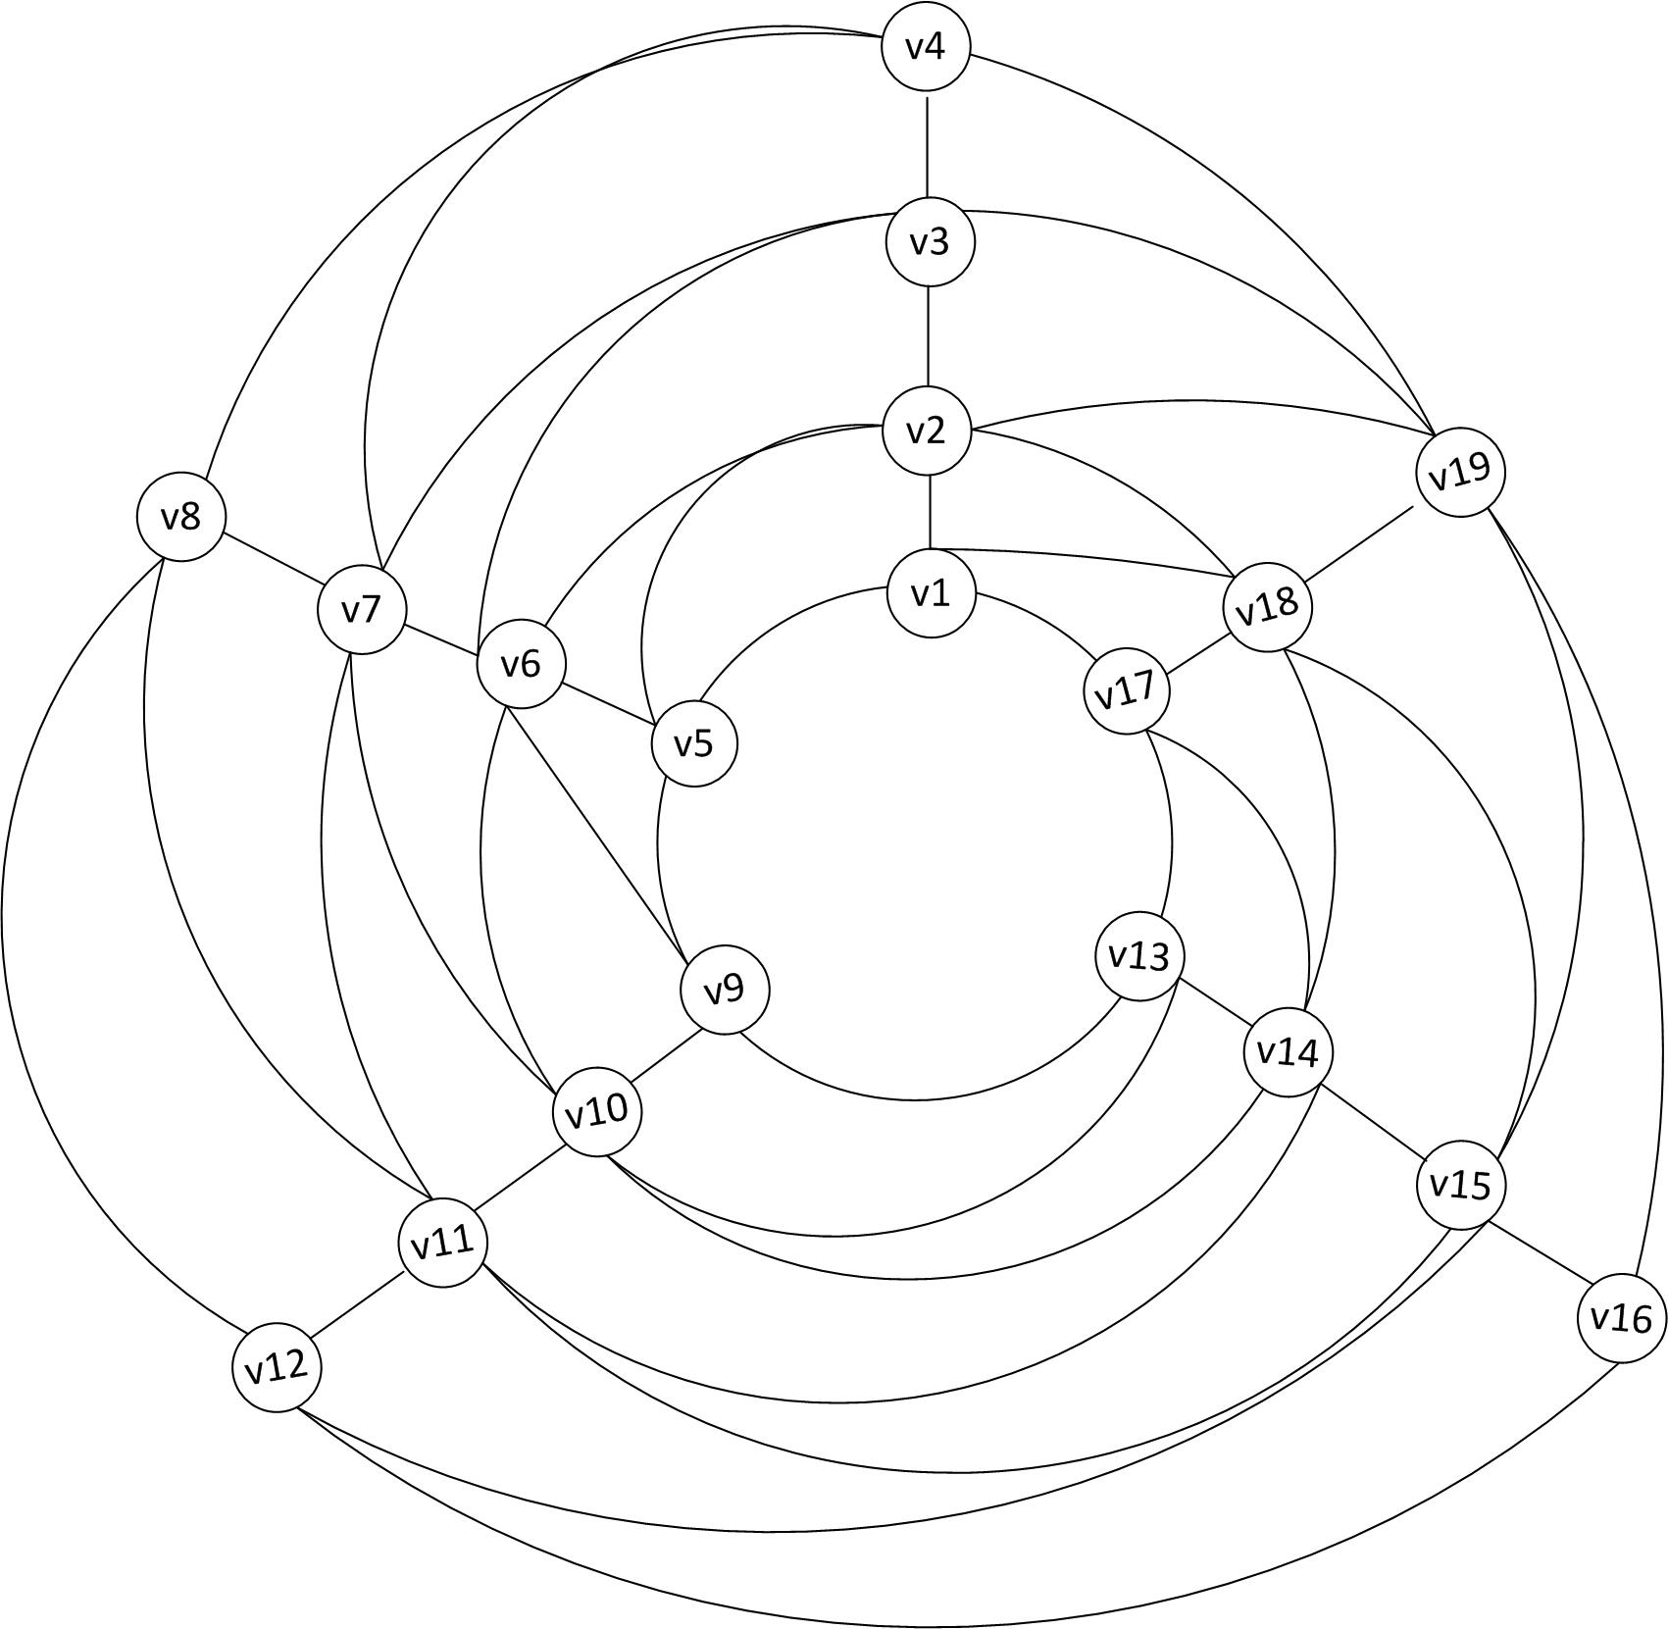
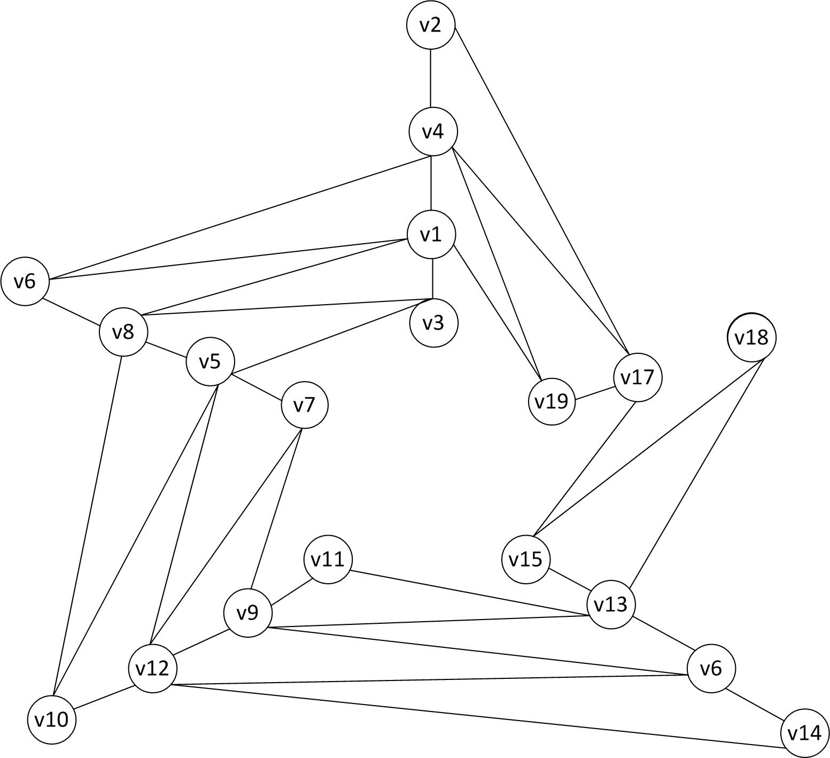
g) Thickness of C₅[4,4,4,4,3] θ(C₅ [4,4,4,4,3]) ≤ 4 (Layers 1 and 2)
θ(C₅ [4,4,4,4,3]) ≥ θ(K₈) = 2

Slide 16
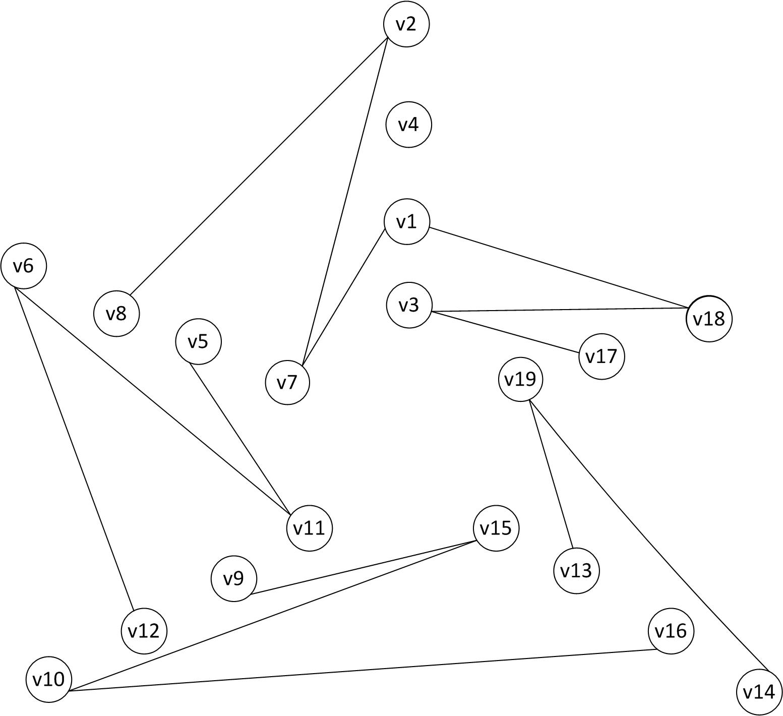
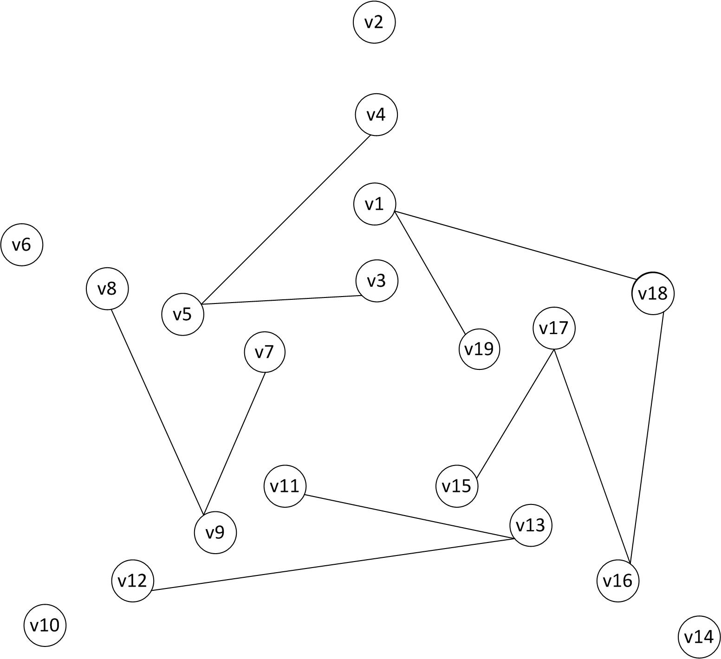
g) Thickness of C₅[4,4,4,4,3] θ(C₅ [4,4,4,4,3]) = 4 (Layers 3 and 4)

Slide 17
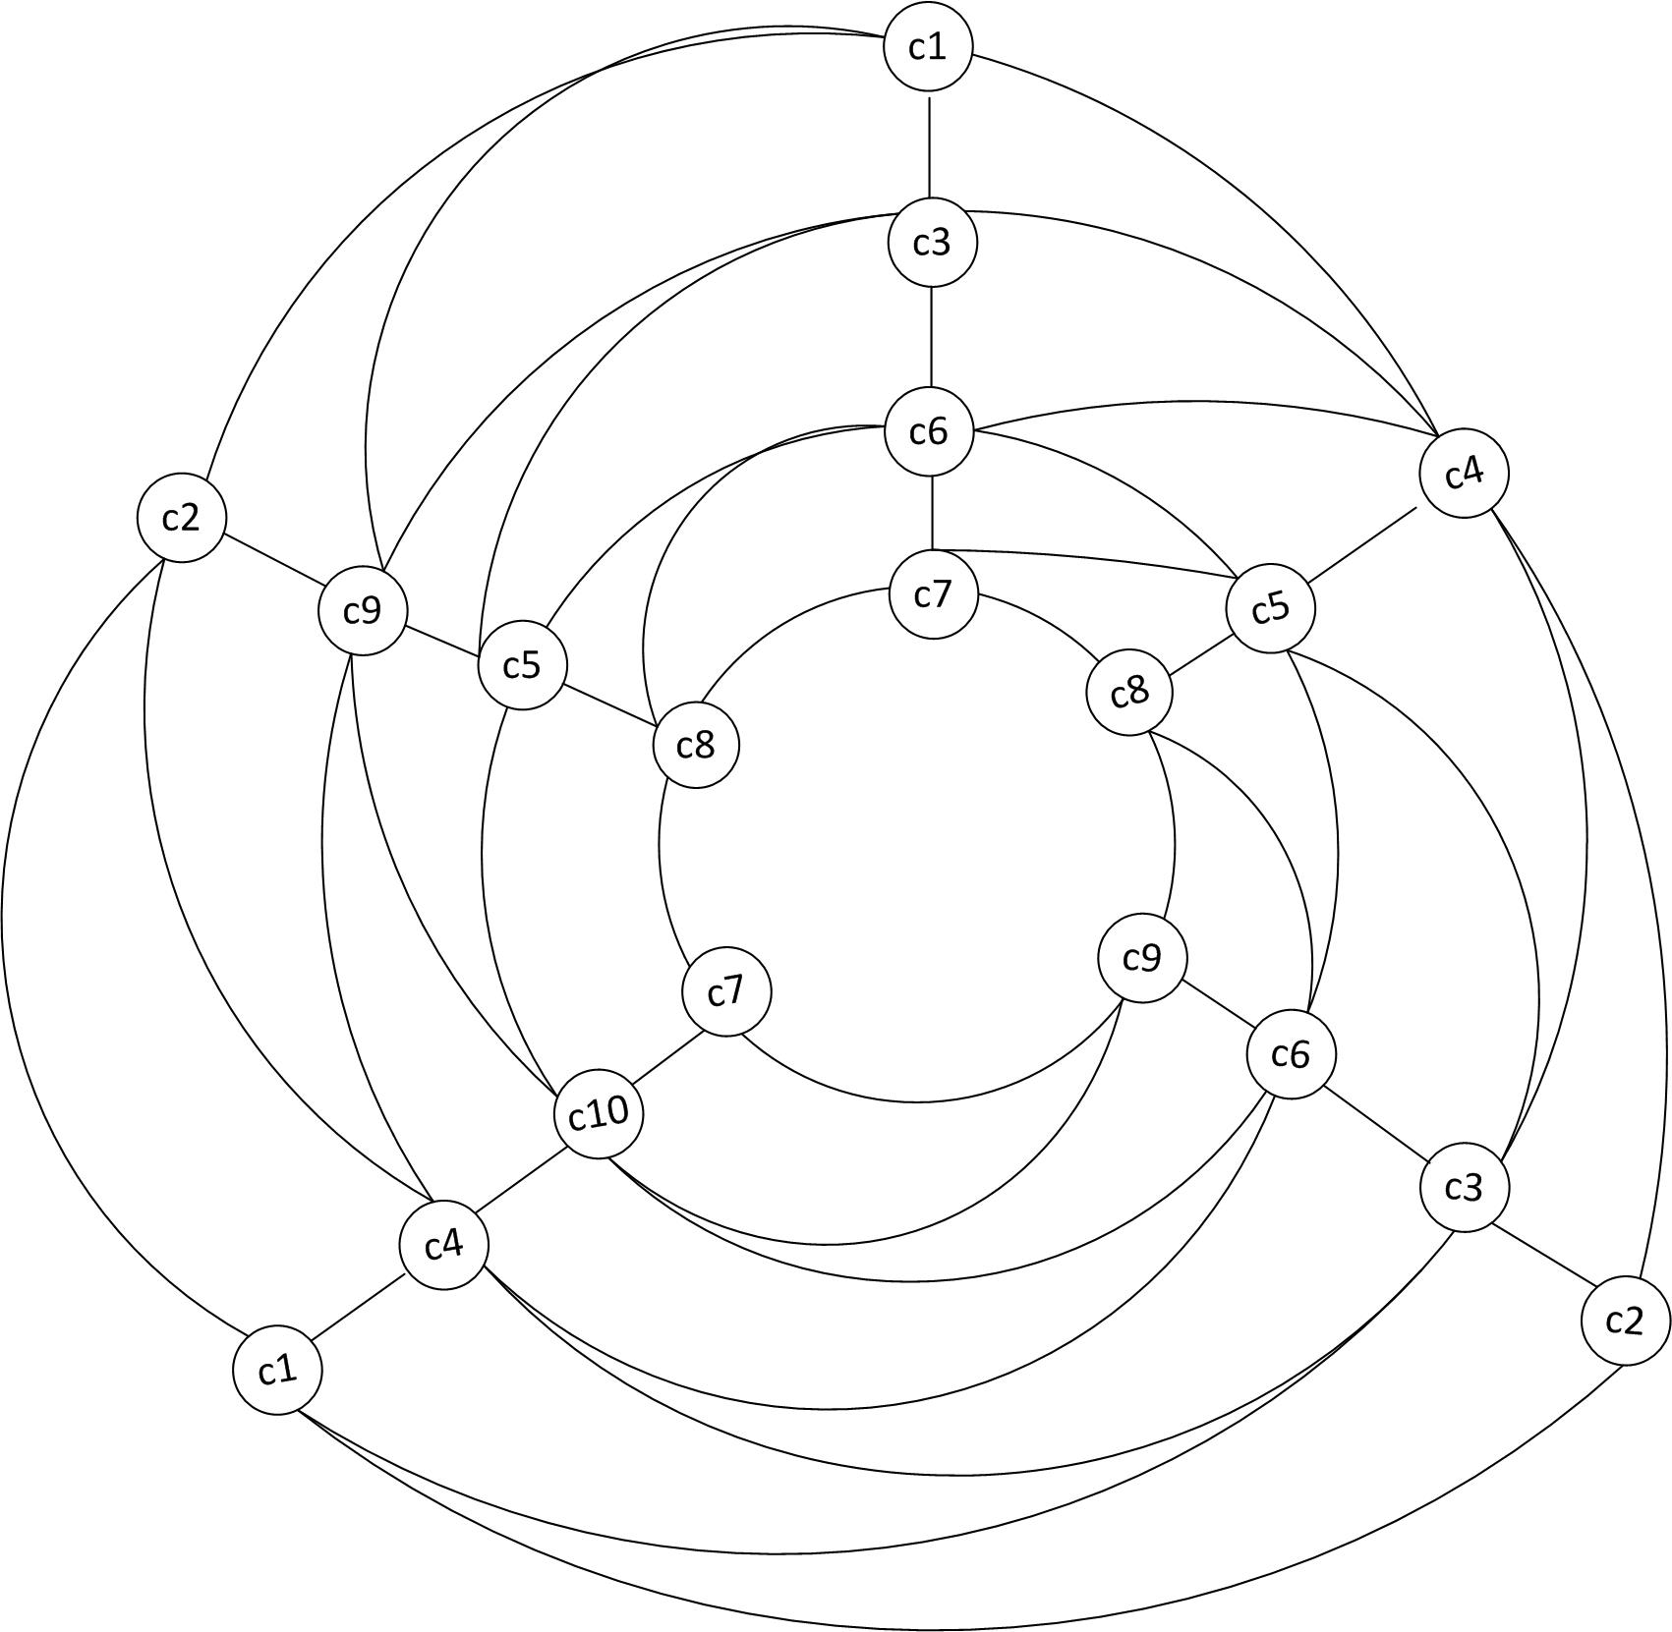
g) Chromatic of C₅[4,4,4,4,3] =10
Lower bound:
X(C₅[4,4,4,4,3] ≥ 19/2
≥ 9.5
Upper Bound:
X(C₅[4,4,4,4,3] ≤ 10
X(C₅[4,4,4,4,3] = 10
QED

Slide 18
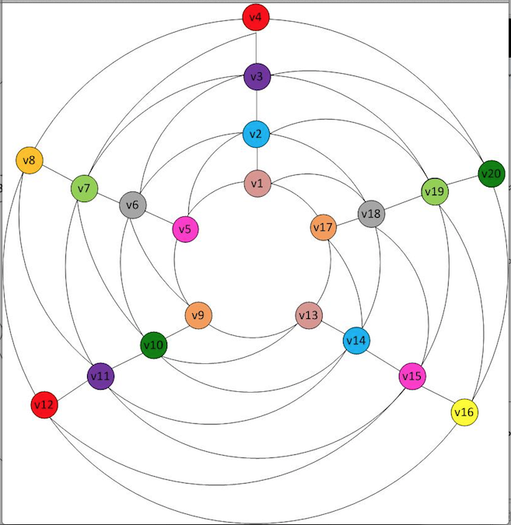
g) Chromatic number of C₅[4,4,4,4,4]
Χ(C₅[4,4,4,4,4])=10

Slide 19
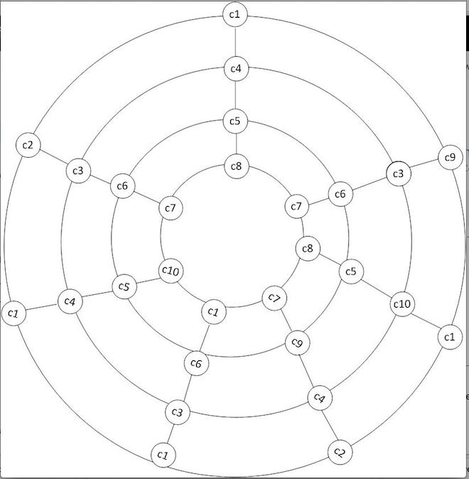
h) Chromatic number of C₇[4,4,4,4,4,4,4] Χ(C₇[4,4,4,4,4,4,4])=10
Lower bound:
X(C₇[K₄] ≥ 28/3
≥ 9.33
Upper Bound:
X(C₅[4,4,4,4,3] ≤ 10
X(C₅[4,4,4,4,3] = 10
QED

Slide 20
h) Thickness of C₇[4,4,4,4,4,4,4]
θ(C₇ [4,4,4,4,4,4,4]) ≤ 4
θ(C₇ [4,4,4,4,4,4,4]) ≥ θ(K₈) = 2

Slide 21
References
Griggs, J. R. (1983). Lower bounds on the independence number in terms of the degrees. Journal of Combinatorial Theory, Series B, 34(1), 22-39.

